Slide 1

Responsible AI toolkits

Slide 2
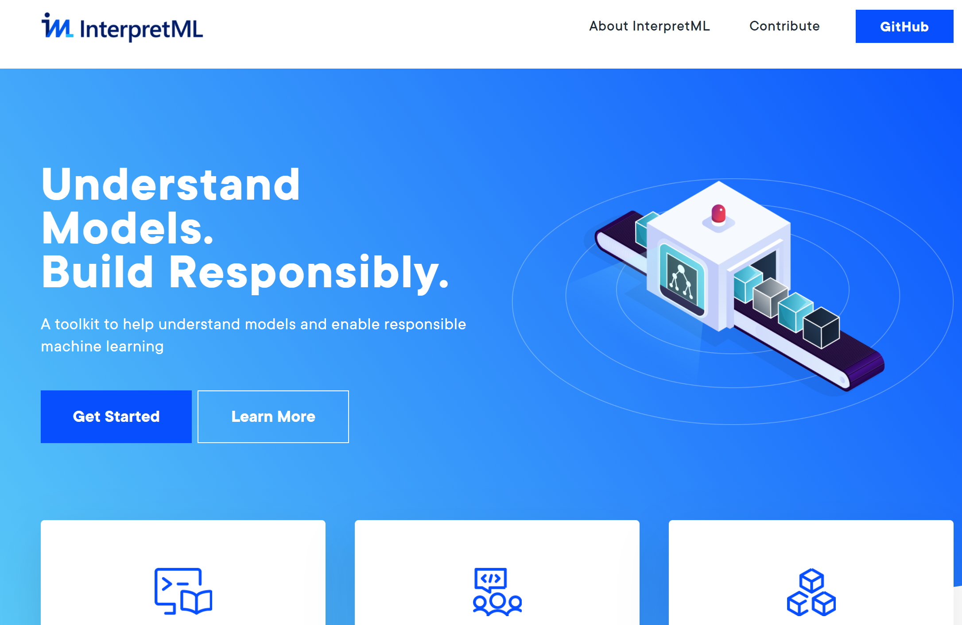
InterpretML

Slide 3
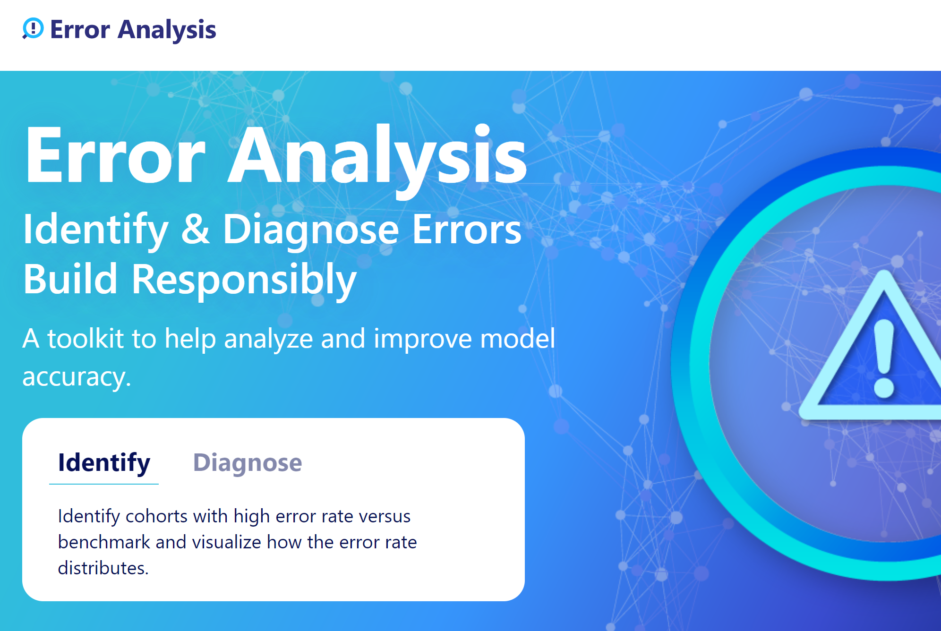
Error Analysis

Slide 4
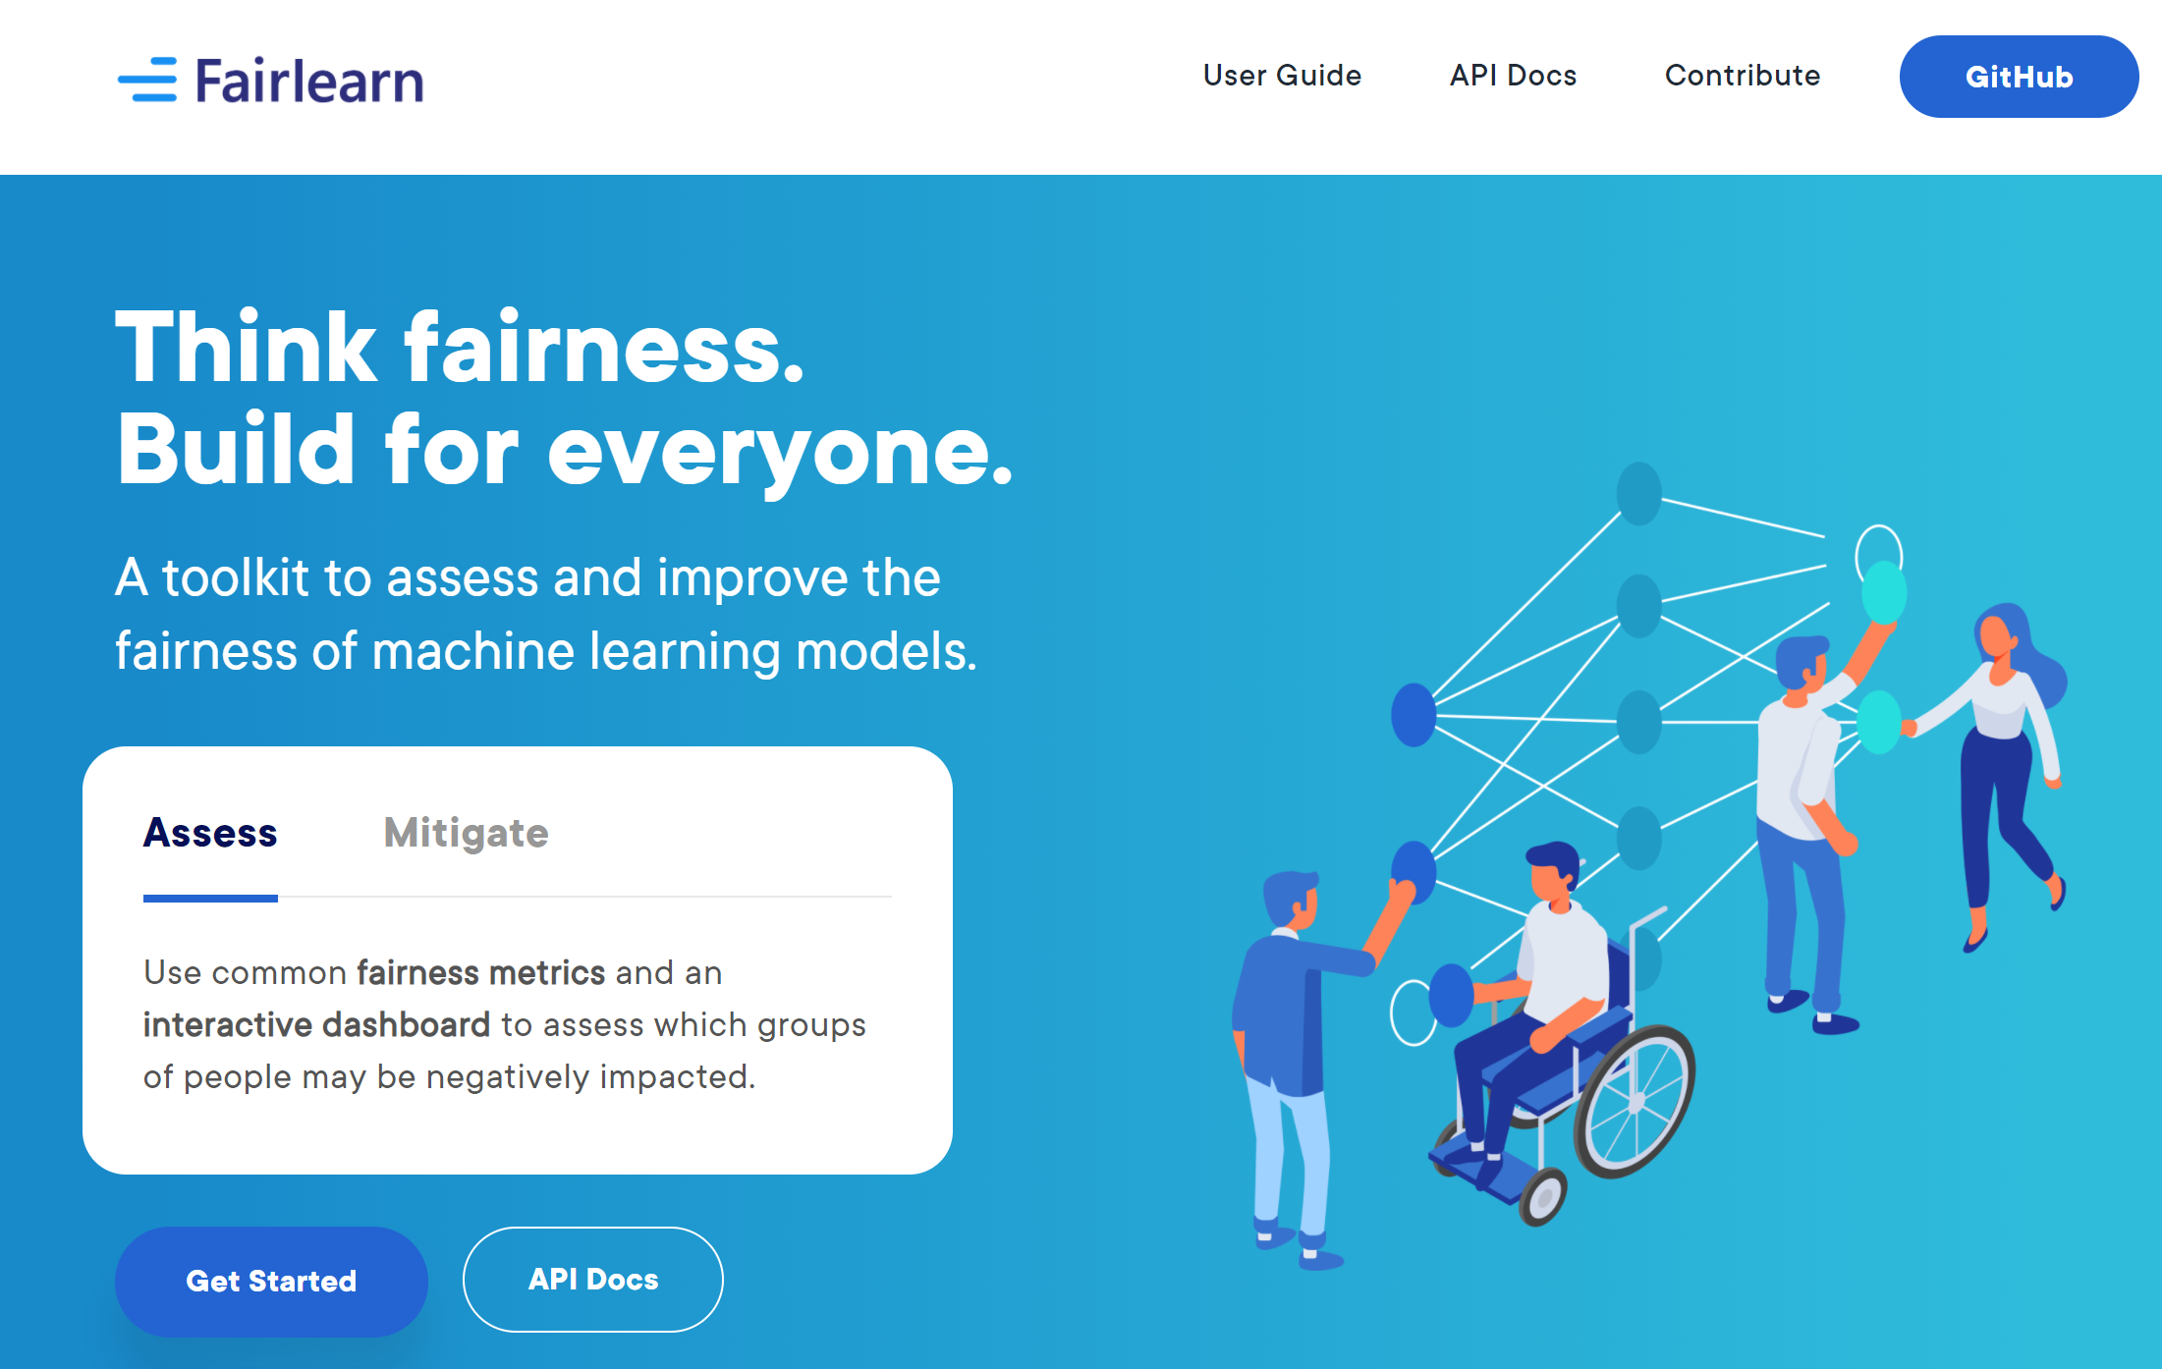
Fairlearn

Slide 5
Quizes – Job attrition
Do older people want to stay? Is there a gender difference? → Age / Gender
How well do we classify? Gender difference? → Classification outcome / Gender

Slide 6
Does Over Time affect attrition? What about Stock Option Level, Monthly Income?

